Slide 1
BIS 403 - Applied Systems Design College: Peirce College Professor: Robert Heubner Group Members: J. Sherif & M. Morrison Case Study: Personal Trainer Case Study #5
Date: 1/31/2024
Tasks 1&2, completed by Jilalo Sherif
Tasks 3&4, completed by Morrese Morrison

Slide 2

Task #1 Actors and Use cases
<<uses>>
Personal Trainer
Training Services
Join Personal Trainer
Trainee
(Actor)

Slide 3
Task #1 Actors and Use cases
<<uses>>
Trainer’s
Schedule
Check hours
Instructors

Slide 4
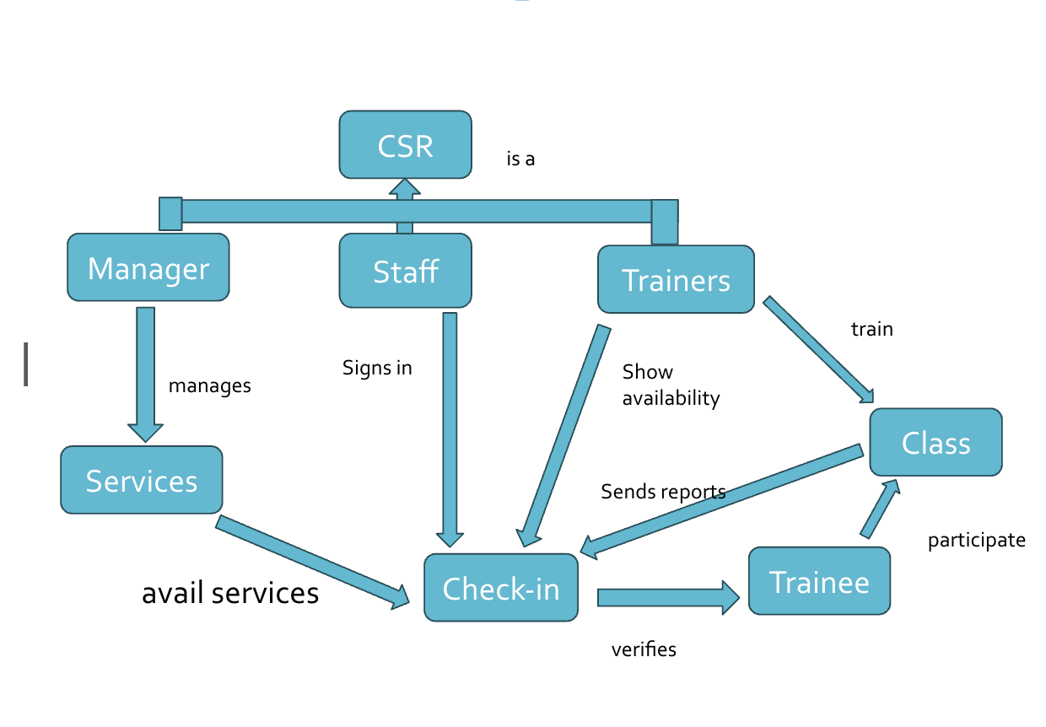
Task #2 Object Relationship

Slide 5
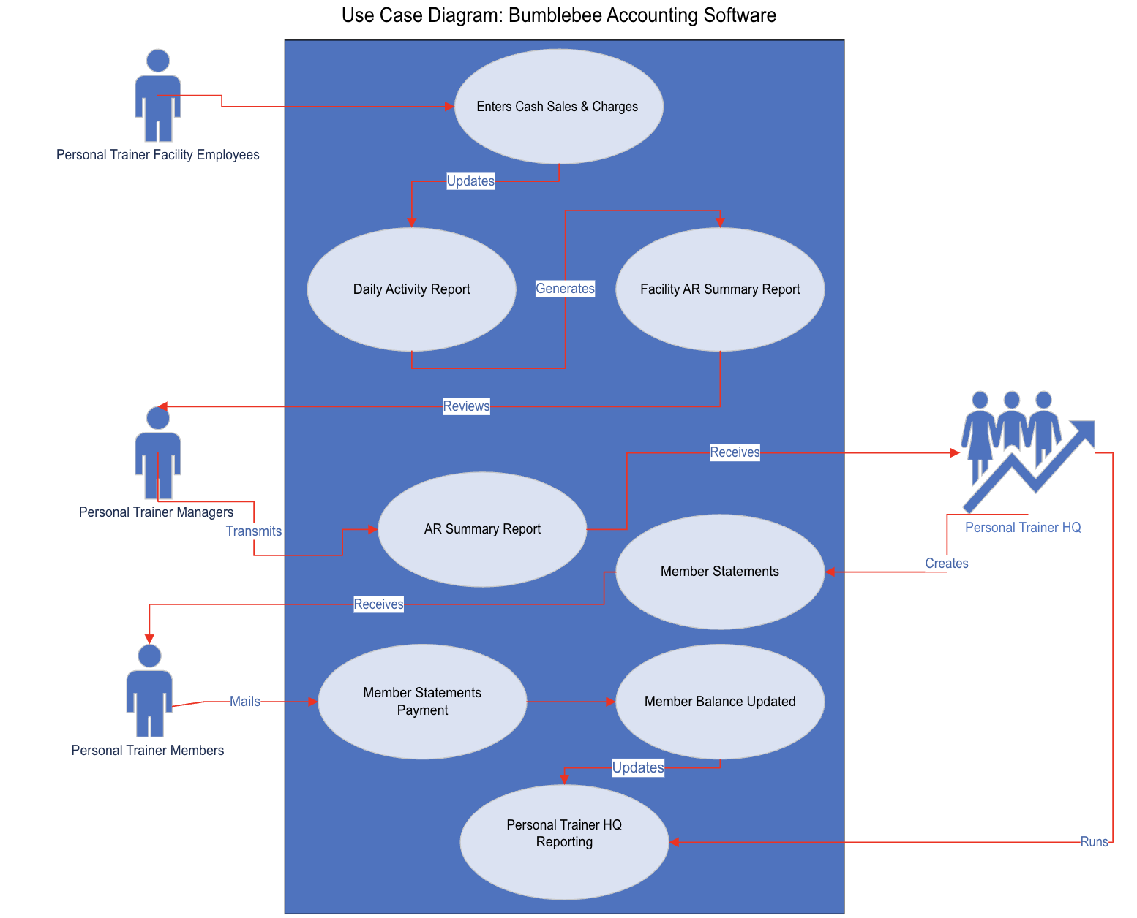
BumbleBee Accounting Software Full Use Case Diagram

Slide 6
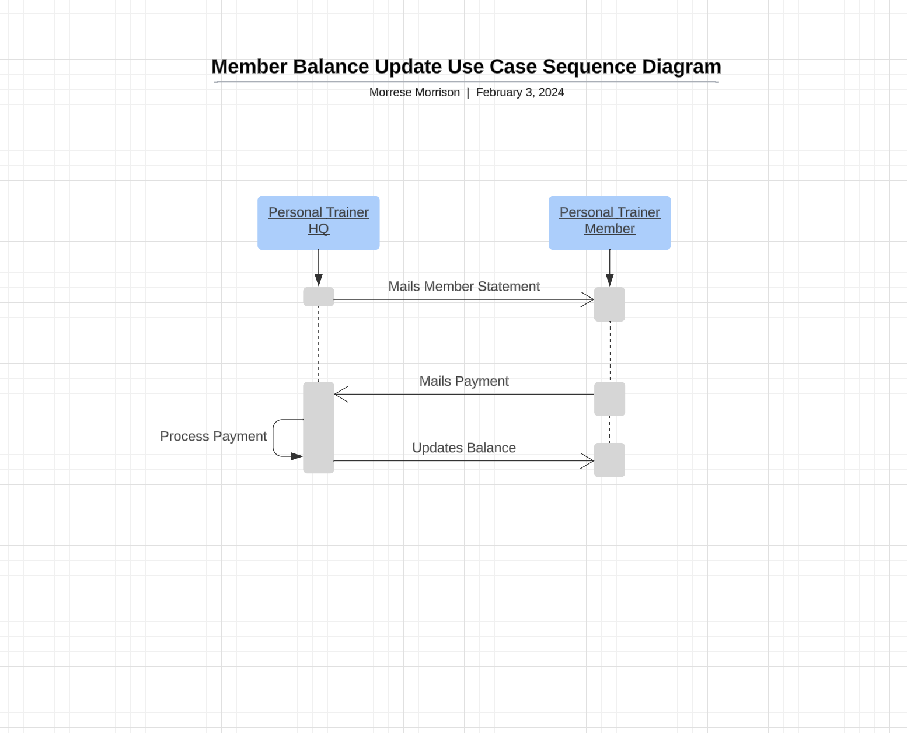
BumbleBee Software Sequence Diagram (Member Balance Update)

Slide 7
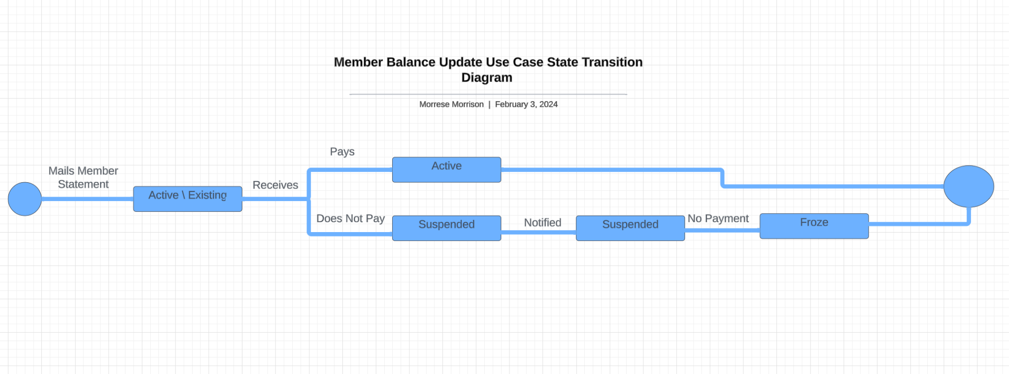
Bumble Accounting Software Use Case State Transition Diagram

